Slide 2
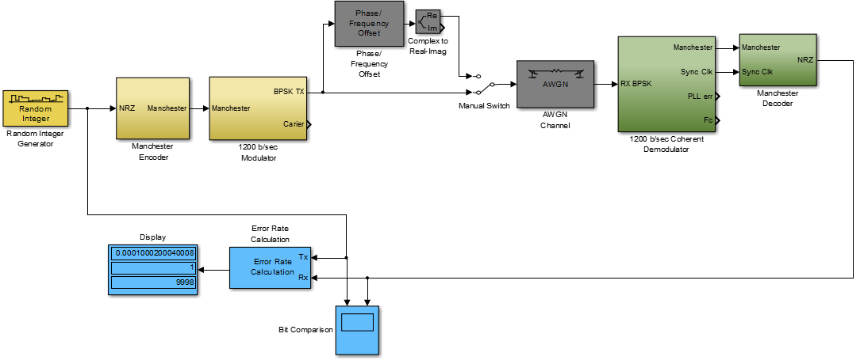
Simulink Model of BPSK Modem

Slide 3
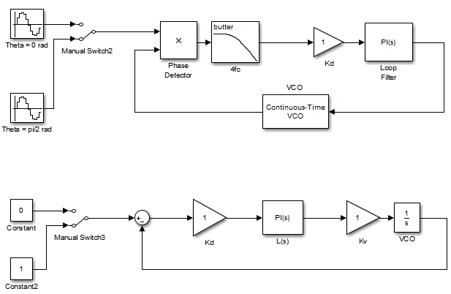
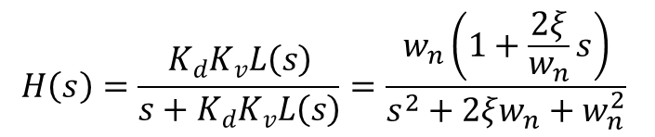
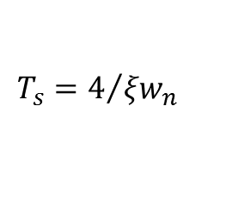
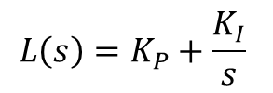
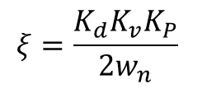

Phase Lock Loop Test and Verification
$$H\left(s\right)=\frac{K_{d}K_{v}L\left(s\right)}{s+K_{d}K_{v}L\left(s\right)}=\frac{w_{n}\left(1+\frac{2ξ}{w_{n}}s\right)}{s^{2}+2ξw_{n}+w_{n}^{2}}$$
$$L\left(s\right)=K_{P}+\frac{K_{I}}{s}$$
$$ξ=\frac{K_{d}K_{v}K_{P}}{2w_{n}}$$
$$w_{n}=\sqrt{K_{d}K_{v}K_{I}}$$
$$T_{s}=4/{{ξw}_{n}}$$

Slide 4
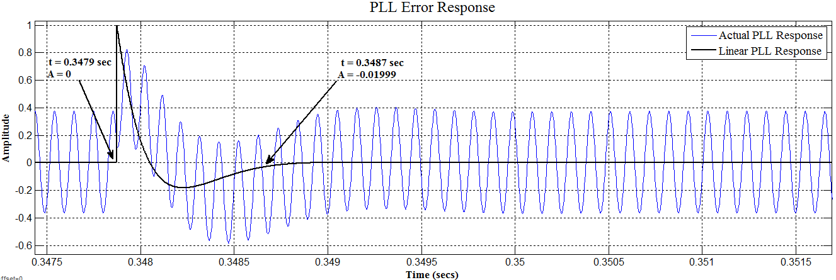
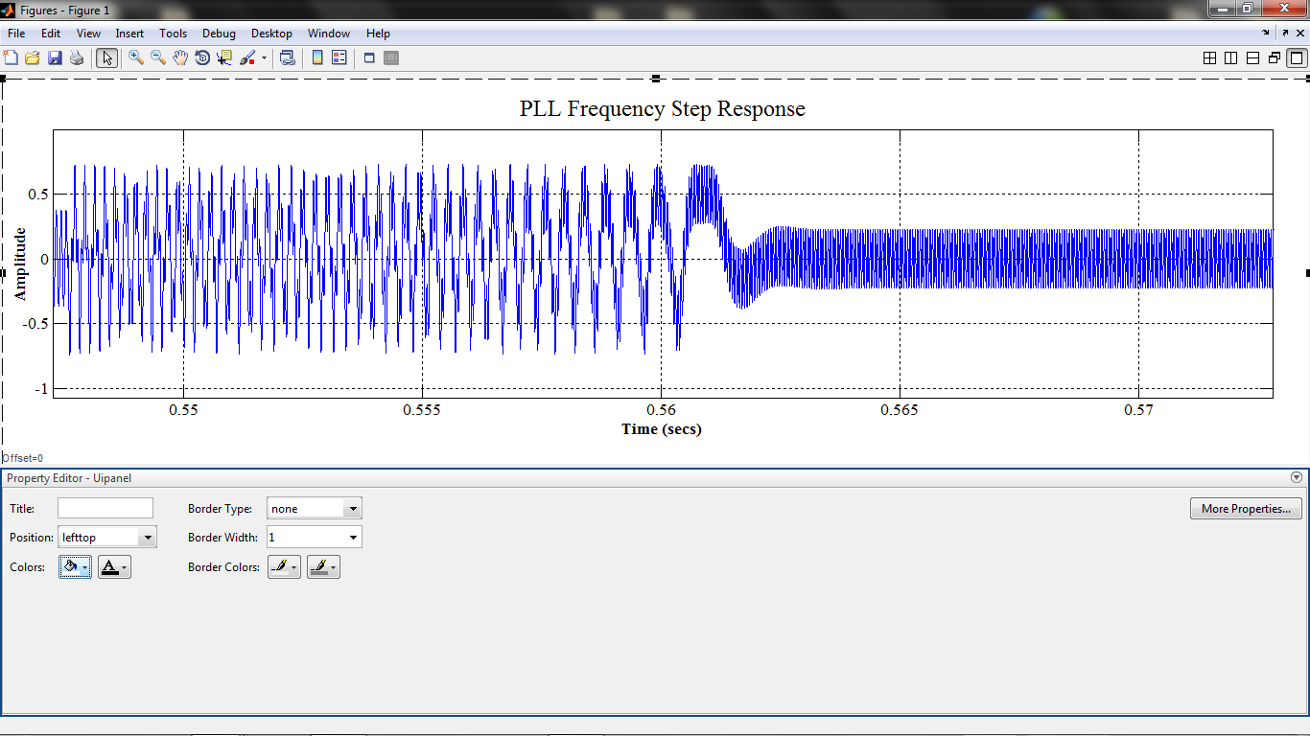
Phase Lock Loop Test Results

Slide 5
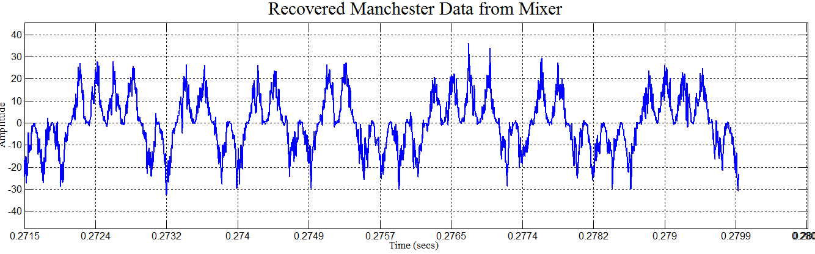
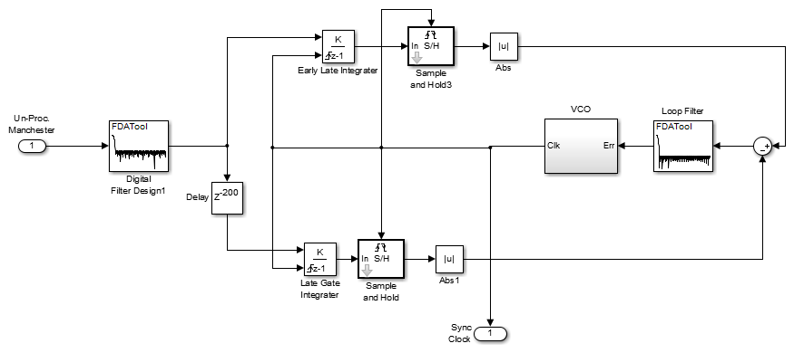
Early-Late Gate Timing Recovery

Slide 6
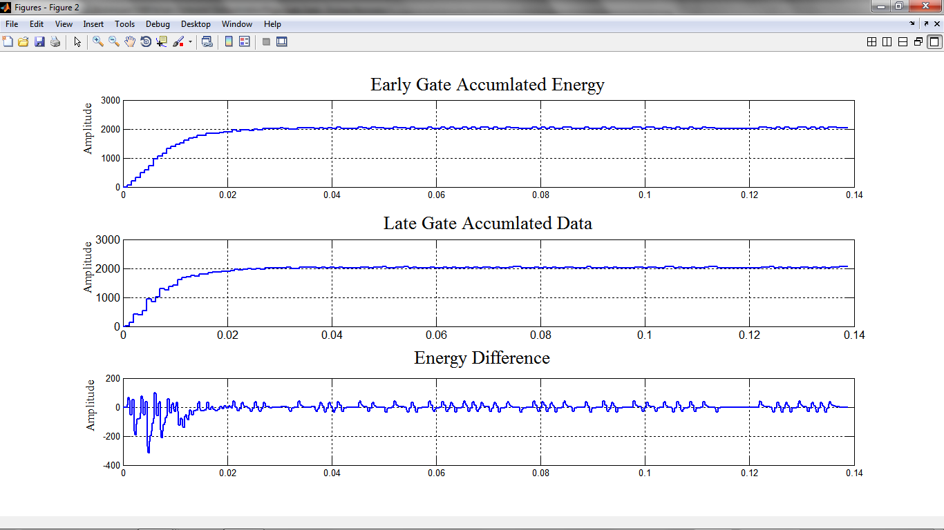
Early-Late Gate Simulation Results

Slide 7
Bit Error Rate Performance in AWGN
SNR (dB) | BER
26 | 0.0001
24 | 0.0002
22 | 0.0014
20 | 0.004601
18 | 0.0126
16 | 0.02951
14 | 0.05071
12 | 0.08321
10 | 0.49139

Slide 8
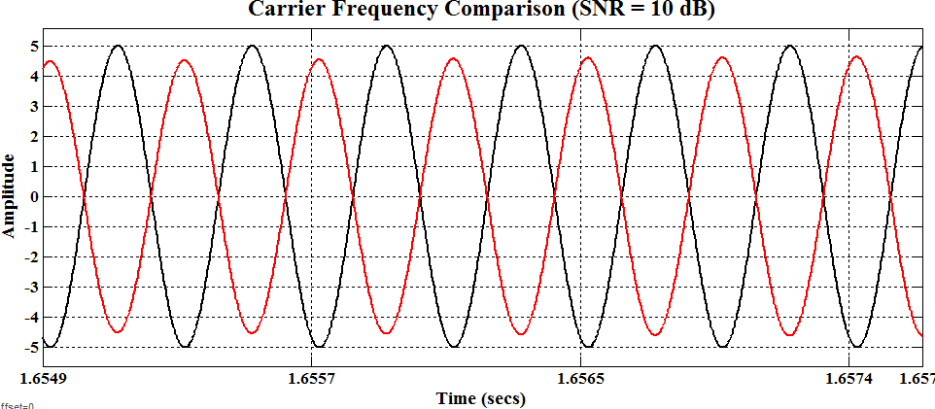
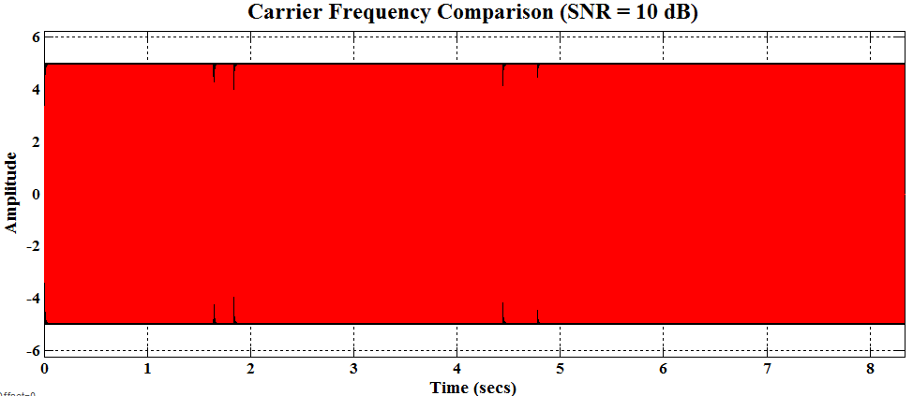
Polarity Reversal at 10 dB
AWGN at 10 dB causes 180 phase shifts resulting in the PLL tracking in the wrong direction
IMPLICATION: Necessitates need for differential encoding

Slide 9
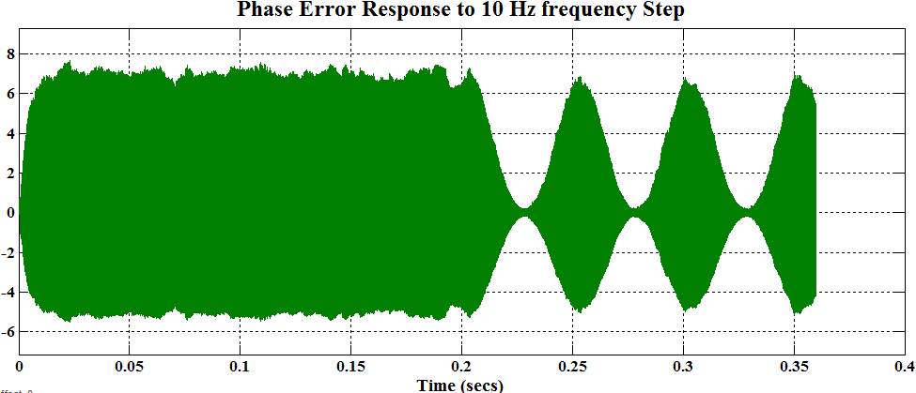
Phase Error Response to Frequency Step
PLL phase error becomes Amplitude Modulated after frequency step
IMPLICATION: Necessitates need for AGC

